Slide 1
Feature Scaling/Normalization?
Explained for Beginners
What is Feature Scaling?
Why it’s important?
Let’s do some practice using python!
Sajjad Mustafa

Slide 2
Imagine, You have to pay 10,000 to two People
One is from Europe
Other one is from USA
1 EUR == 1.22 USD
10,000 EUR == 12,249 USD
Feature Scaling

Slide 3
Importance
in
Machine Learning
Ranges of:
Age (0 to 150)
Salary (20k to 500k)

Slide 4
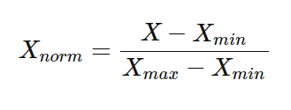

MinMax Scaler
Standard Scaler
Methods

Slide 5
Practice
Let’s go to jupyter notebook

Slide 6
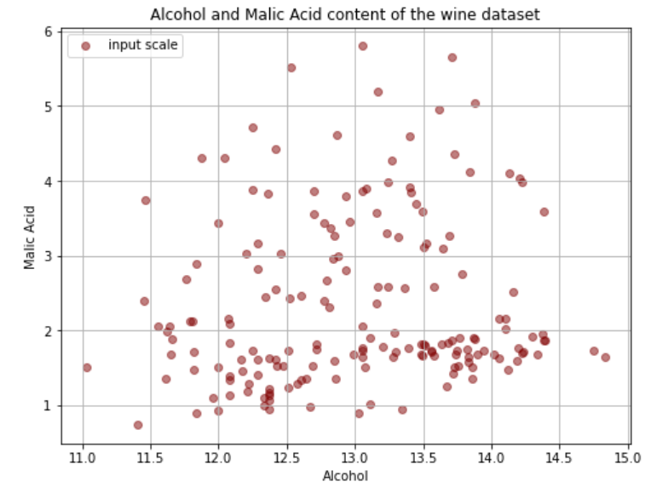
Before

Slide 7
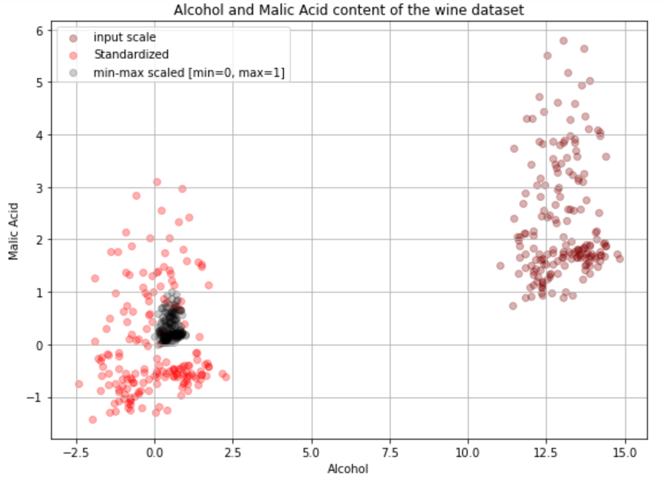
After

Slide 8
Website : www.aisciences.io

